Slide 1
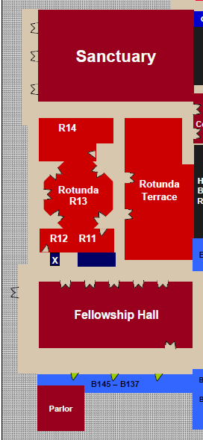
1st Floor
Coming
From
Parking
Lot
June 9
Meeting
1st Floor
Parlor
Room

